Slide 1
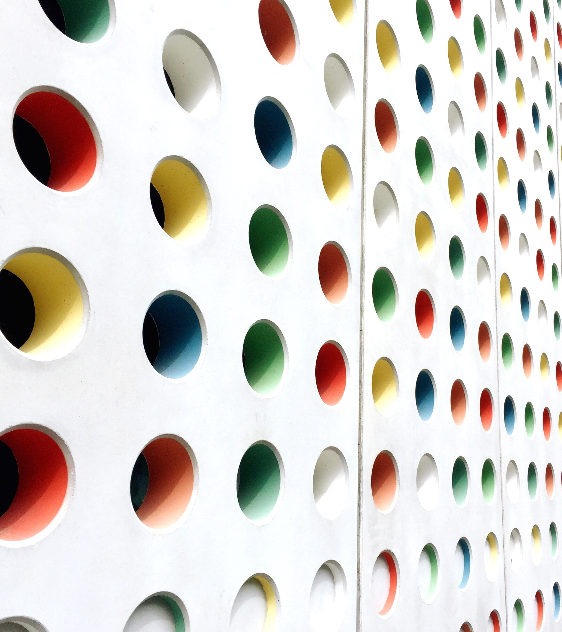
Technical Security Architecture
A flight over the cuckoo’s nest

Slide 2
What are we looking at? (when flying high over the cuckoo’s nest)
What is it?
Where do we start?
What do we look for?
Evidence!!!
More evidence!!!
Drawings

Slide 3
What IS IT? (non-pretentious definition)
An overview of the technical decisions in order to give a direction and implement the high-level plan (architecture) to secure the enterprise
It should align with the security policies of the company (if there are any)
It should ne measurable
AND
It should be measurable in an automated way ;)
What is it? # Where do we start? # What do we look for? # Evidence # Drawings

Slide 4
Where do we start? (..somewhere in the middle..)
It is always good to understand what is already in place
(procedures, enterprise architecture, security policies, technical setup)
And what is important for the particular business
And how far they are prepared to go within the next months and year (to prioritize)
Be aware you cannot fix everything!
What is it? # Where do we start? # What do we look for? # Evidence # Drawings

Slide 5

What do we look for? (here come the cis controls)
A very good to tough all domains is to follow the CIS controls (https://www.cisecurity.org/controls/cis-controls-list/)
An excellent ‘forget-me-not’ for all key security points
compensating controls
achievable targets
solid base principles (basic CIS controls).
What is it? # Where do we start? # What do we look for? # Evidence # Drawings

Slide 6
What do we look for? (an architectural process)
Togaf /Sabsa
Togaf: cyclic / improve security in a controlled way
Sabsa: very fluffy => high costs
Security maturity -> Sabsa
Most enterprises: not.
https://www.opengroup.org/togaf
https://sabsa.org/
https://sabsa.org/sabsa-executive-summary/
What is it? # Where do we start? # What do we look for? # Evidence # Drawings

Slide 7
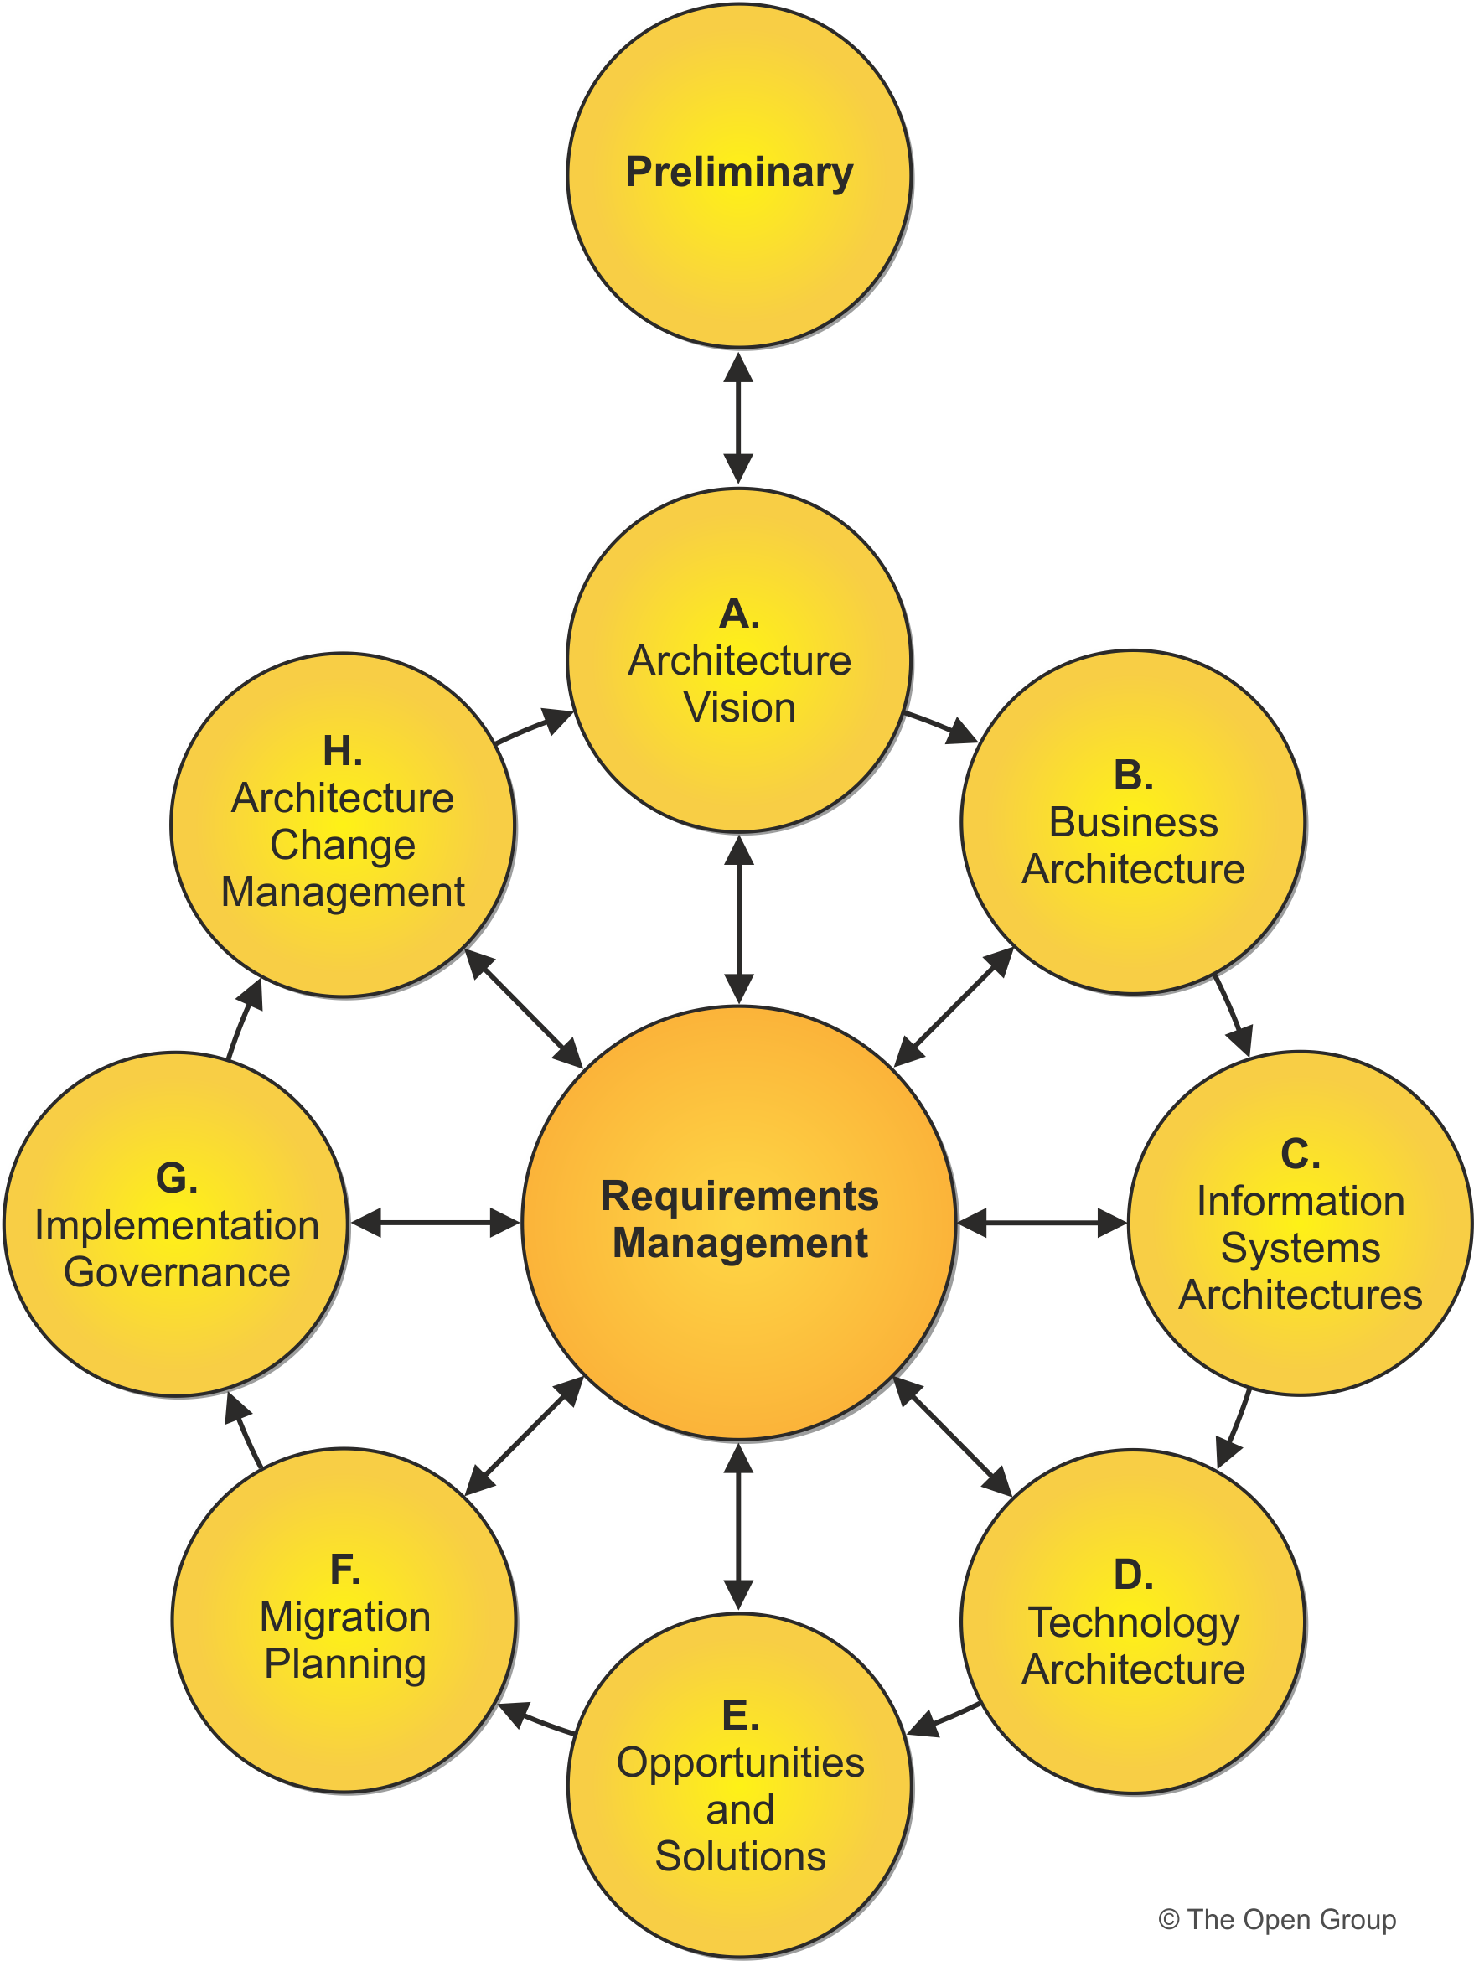
togaf (an overview)
Smaller, qualitative steps
Align with enterprise security
Prioritize
Periodical review cycle
Define projects
Automation
Automation
Automation

Slide 8
evidence (measure it)
The technical architecture should include the process of measuring the implemented security controls in the defined projects
Never design something which cannot be measured
Measuring a security solution should be included in the project when possible
It helps in the next (Togaf) iteration if the decision can be made based on evidence
Example: email migration – malware incidents reports
What is it? # Where do we start? # What do we look for? # Evidence # Drawings

Slide 9
More evidence (measure it … again)
Measure all the technical controls after each major change caused by projects
Measure using automated controls (tooling, scripts)
Results should be recorded and used in correlations and reporting
What is it? # Where do we start? # What do we look for? # Evidence # Drawings

Slide 10
drawings (because *almost* no one is reading the text)
Most people do not read all text
Drawings remain as reference
Try to illustrate complex approaches with drawings
Try to know your audience
What is it? # Where do we start? # What do we look for? # Evidence # Drawings

Slide 11
Example 1 addressing the malware problem

Slide 12
Example 2 policies – they apply to all solutions equally

Slide 13
So many … questions !?!
After a very high-level flight over

